Slide 1
MVC

Slide 2
MVC Pattern
The Model-View-Controller (MVC) framework is an architectural pattern that separates an application into three main logical components.
Model, View, and Controller.
Hence the abbreviation MVC.
Each architecture component is built to handle specific development aspect of an application.

Slide 3
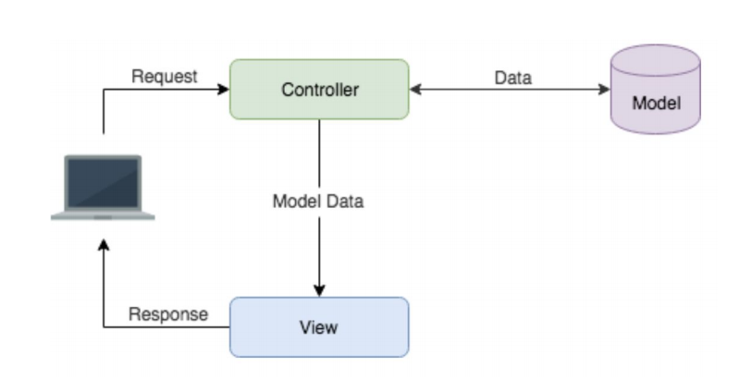

Slide 4
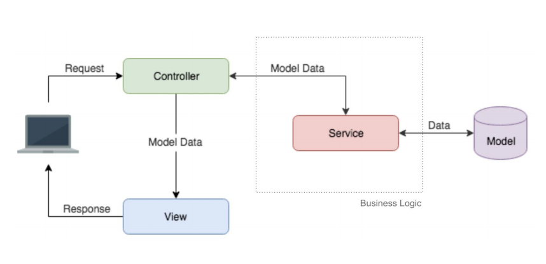

Slide 5
Controllers
Entry point of any application.
They’re accessed via url mappings.
The only validate that incoming request has all the needed params.
They DO NOT HOLD any business logic.
They trust on services to process each new request.
They return the response to the client without adding any additional data.

Slide 6
Services
They contains the entire business logic of our application.
Each service is responsible of handling a particular and unique entity (users service, items service...)
They invoke other services, models, external providers and any other needed data source.
They handle errors, send metrics, send logs, tags and any other support metric needed by our application.

Slide 7
Model / Domain
This is the only layer where we know about persistence. Only they know where and how they should persist
They hold the core domains of our services.
They are in charge of defining the structure of domain objects.
They are in charge of abstracting persistence logic by creating a clean and general interface.

